Slide 1



Hospital Management System Database
My Hospital Management System (HMS) is designed to efficiently manage hospital operations by maintaining systematic and standardized records for patients, doctors, and rooms, all controlled by an administrator. Each patient and doctor has a unique identifier, ensuring seamless tracking of ongoing treatments. Key features include modules for hospital admission, discharge summaries, nursing duties, ward management, and medical stores, making it a comprehensive solution for enhancing hospital efficiency and patient care.
by Pramod Rawat

Slide 2
Patient Table
CREATE TABLE Patients(
PatientID INT PRIMARY KEY,
Name VARCHAR(100) NOT NULL,
Age INT CHECK (Age > 0),
Gender CHAR(1) CHECK (Gender IN ('M', 'F')),
Address VARCHAR(255),
Phone VARCHAR(15),
Email VARCHAR(100) UNIQUE,
MedicalHistory TEXT,
CurrentTreatment VARCHAR(255),
RoomID INT,
FOREIGN KEY (RoomID)REFERENCES Rooms(RoomID));
by Pramod Rawat

Slide 3
Doctor Table
CREATE TABLE Doctors (
DoctorID INT PRIMARY KEY,
Name VARCHAR(100) NOT NULL,
Specialization VARCHAR(100),
Phone VARCHAR(15),
Email VARCHAR(100) UNIQUE,
Department VARCHAR(100),
RoomID INT,
FOREIGN KEY (RoomID) REFERENCES Rooms(RoomID) );
by Pramod Rawat

Slide 4
Nurses Table
CREATE TABLE Nurses (
NurseID INT PRIMARY KEY,
Name VARCHAR(100) NOT NULL,
Phone VARCHAR(15),
Email VARCHAR(100) UNIQUE,
DutyShift VARCHAR(50),
WardBoyID INT,
FOREIGN KEY (WardBoyID) REFERENCES WardBoys(WardBoyID))
by Pramod Rawat

Slide 5
Admission Table
CREATE TABLE Admissions (
AdmissionID INT PRIMARY KEY,
PatientID INT,
DoctorID INT,
AdmissionDate DATE,
Reason VARCHAR(255),
RoomID INT,
FOREIGN KEY (PatientID) REFERENCES Patients(PatientID),
FOREIGN KEY (DoctorID) REFERENCES Doctors(DoctorID),
FOREIGN KEY (RoomID) REFERENCES Rooms(RoomID))
by Pramod Rawat

Slide 6
Discharge Summaries Table
CREATE TABLE DischargeSummaries (
DischargeID INT PRIMARY KEY,
PatientID INT,
DischargeDate DATE,
Summary TEXT,
DoctorID INT,
FOREIGN KEY (PatientID) REFERENCES Patients(PatientID),
FOREIGN KEY (DoctorID) REFERENCES Doctors(DoctorID))
by Pramod Rawat

Slide 7
Treatments Table
CREATE TABLE Treatments ( TreatmentID INT PRIMARY KEY,
PatientID INT,
DoctorID INT,
TreatmentDate DATE,
Description TEXT,
FOREIGN KEY (PatientID) REFERENCES Patients(PatientID),
FOREIGN KEY (DoctorID) REFERENCES Doctors(DoctorID))
by Pramod Rawat

Slide 8
Rooms Table
CREATE TABLE Rooms (
RoomID INT PRIMARY KEY,
RoomNumber VARCHAR(10),
Type VARCHAR(50),
Capacity INT,
Status VARCHAR(50))
by Pramod Rawat

Slide 9
Ward Boys Table
CREATE TABLE WardBoys (
WardBoyID INT PRIMARY KEY,
Name VARCHAR(100) NOT NULL,
Phone VARCHAR(15),
Email VARCHAR(100) UNIQUE,
DutyShift VARCHAR(50))
by Pramod Rawat

Slide 10
Medical Store Table
CREATE TABLE MedicalStores (
StoreID INT PRIMARY KEY,
MedicineID INT,
Stock INT,
ExpiryDate DATE)
by Pramod Rawat

Slide 11
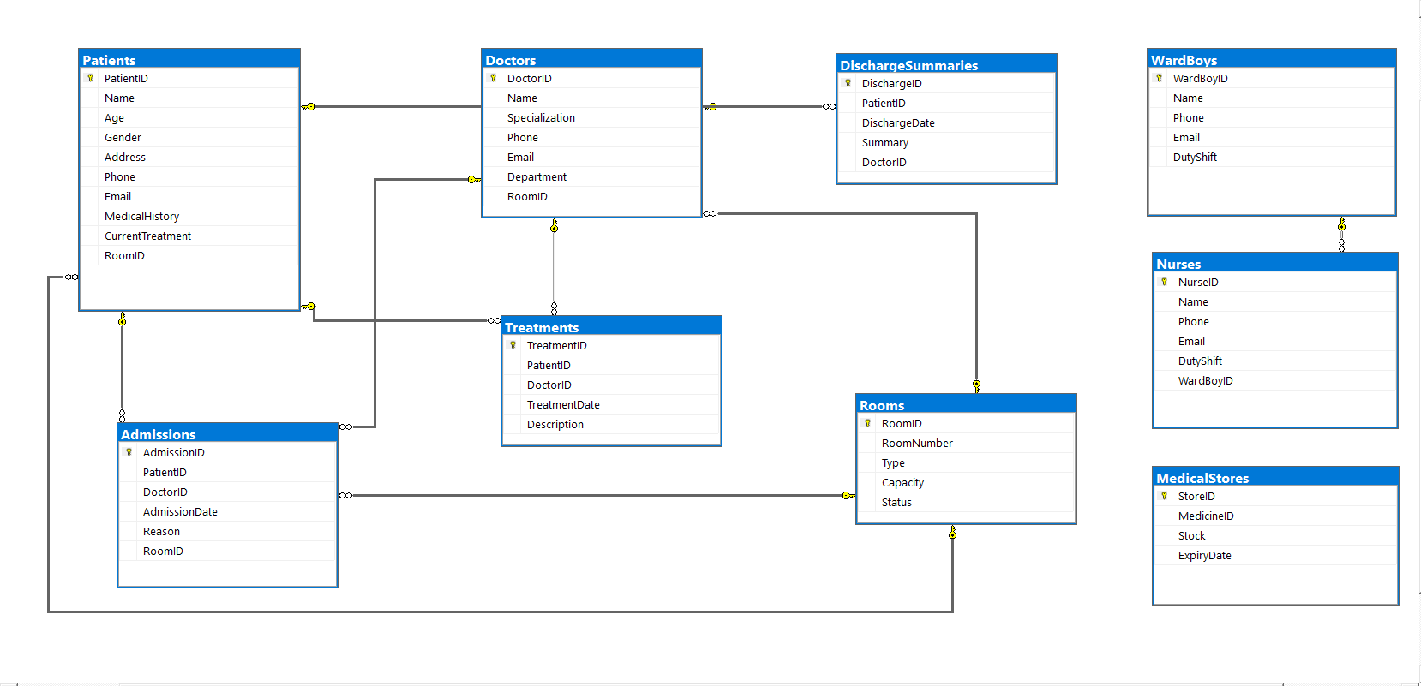
ER Diagram
by Pramod Rawat

Slide 12
HMS Based Queries
1. Find all patients assigned to a specific doctor and their room details ?
SELECT
P.Name AS [PatientName], P.RoomID, R.RoomNumber, D.Name AS [DoctorName]
FROM Patients P
JOIN Rooms R ON P.RoomID = R.RoomID
JOIN Admissions A ON P.PatientID = A.PatientID
JOIN Doctors D ON A.DoctorID = D.DoctorID
WHERE D.Name = 'Dr. Sakshi Rawat'
by Pramod Rawat

Slide 13
HMS Based Queries
2. List all patients who have been admitted more than once?
SELECT
P.Name AS PatientName, COUNT(A.AdmissionID) AS [AdmissionCount]
FROM Patients P
JOIN Admissions A ON P.PatientID = A.PatientID
GROUP BY P.Name
HAVING COUNT(A.AdmissionID) > 1
by Pramod Rawat

Slide 14
HMS Based Queries
3. Find the average age of patients in each room type ?
SELECT
R.Type AS RoomType, AVG(P.Age) AS AverageAge
FROM Patients P
JOIN Rooms R ON P.RoomID = R.RoomID
GROUP BY R.Type;
by Pramod Rawat

Slide 15
HMS Based Queries
4. Retrieve all treatments provided by a specific doctor within the last month ?
SELECT
T.Description AS TreatmentDescription, T.TreatmentDate, P.Name AS PatientName
FROM Treatments T
JOIN Patients P ON T.PatientID = P.PatientID
JOIN Doctors D ON T.DoctorID = D.DoctorID
WHERE D.Name = 'Dr. Sakshi Rawat' AND T.TreatmentDate
>= DATEADD(MONTH, -1, GETDATE());
by Pramod Rawat

Slide 16
HMS Based Queries
5. List all ward boys and the nurses assigned to them ?
SELECT
WB.Name AS WardBoyName, N.Name AS NurseName
FROM WardBoys WB
JOIN Nurses N ON WB.WardBoyID = N.WardBoyID;
by Pramod Rawat

Slide 17
HMS Based Queries
6. Find all doctors who have discharged more than 10 patients ?
SELECT
D.Name AS DoctorName, COUNT(DISTINCT DS.DischargeID) AS DischargeCount
FROM Doctors D
JOIN DischargeSummaries DS ON D.DoctorID = DS.DoctorID
GROUP BY D.Name
HAVING COUNT(DISTINCT DS.DischargeID) > 10;
by Pramod Rawat

Slide 18
HMS Based Queries
7. Get details of all patients who were admitted but not yet discharged ?
SELECT
P.Name AS PatientName, A.AdmissionDate, R.RoomNumber
FROM Patients P
JOIN Admissions A ON P.PatientID = A.PatientID
JOIN Rooms R ON A.RoomID = R.RoomID
LEFT JOIN DischargeSummaries DS ON P.PatientID = DS.PatientID
WHERE DS.DischargeID IS NULL;
by Pramod Rawat

Slide 19
HMS Based Queries
8. Calculate the total number of medicines in stock in the medical store ?
SELECT
SUM(Stock) AS TotalMedicinesInStock
FROM MedicalStores;
by Pramod Rawat

Slide 20
HMS Based Queries
9. Find all rooms that are currently unoccupied ?
SELECT *
FROM Rooms
WHERE Status = 'Unoccupied'
by Pramod Rawat

Slide 21
HMS Based Queries
10. List all doctors and the number of treatments they have provided ?
SELECT
D.Name AS DoctorName, COUNT(T.TreatmentID) AS TreatmentCount
FROM Doctors D
JOIN Treatments T ON D.DoctorID = T.DoctorID
GROUP BY D.Name;
by Pramod Rawat

